Slide 1
YEAR 4 CURRICULUM INFORMATION EVENING 2023

Slide 2
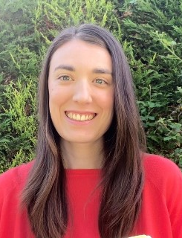
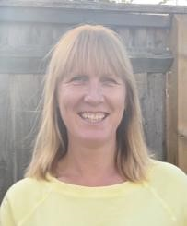
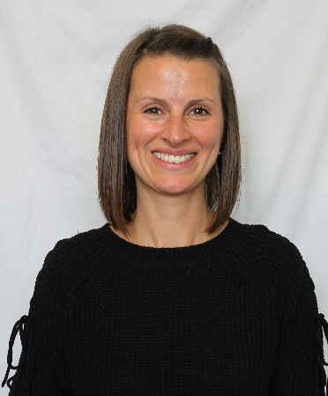
The Year 4 Team
4P
Miss Plumley – Class Teacher & Team Leader
Mr Clark– PPA/Leadership Cover
Mrs Platt– Learning Mentor
4R
Mrs Nicholls – Class Teacher (M)
Mrs Vickers – Class Teacher (T/W/Th/F)
Mrs McBain and Mrs Gordon – Learning Mentors
4B
Mrs Bryce – Class Teacher
Mrs Nicholls– PPA Cover
Mrs Holt and Mrs Gray – Learning Mentors

Slide 3
Our Core Values
Our core values guide the actions of our staff and children and bind us together as a strong community.
We are caring and we are kind.
We are always ready to learn.
We are determined and we are resilient.
We embrace difference and diversity.
We have a voice and we listen to others.
We encourage and we cooperate.
We contribute positively to our community.
We are environmentally responsible.

Slide 4
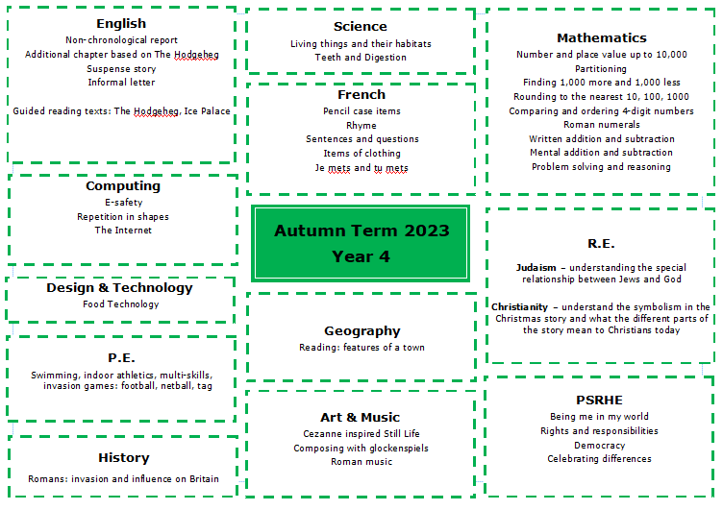

Slide 5
English
The majority of our writing is linked to the texts we read in Guided Reading or our history and geography topics.
This term, we are writing non-chronological reports and additional chapters linked to our text The Hodgeheg. In Autumn 2, we will be writing suspense stories and informal letters linked to Ice Palace.

Slide 6
Reading
Each term children take a Star Reader assessment which gives each child a ZPD score (this is the recommendation of book levels that this child should read to provide optimal challenge without frustration.)
Children are encouraged to choose a reading book within this range from their class library.
Accelerated Reader Quizzes – children take a quiz about the book within 48hrs of finishing a book to earn points.

Slide 7
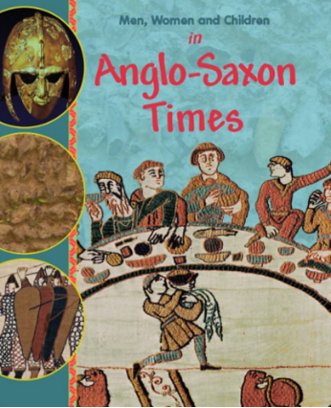
Guided Reading

Slide 8
maths
We follow the White Rose maths scheme with challenge provided from Planpanion. Each lesson provides the opportunity for children to develop their fluency, reasoning and problem solving skills.

Slide 9
Multiplication Tables Check
Taken in June 2024
Purpose: to determine whether your child can fluently recall their times tables up to 12, which is essential for future success in mathematics.

Slide 10
New Times Table Passports
St Paul’s CE Junior School’s
100 Club
Name___________________
Class __________

Slide 11
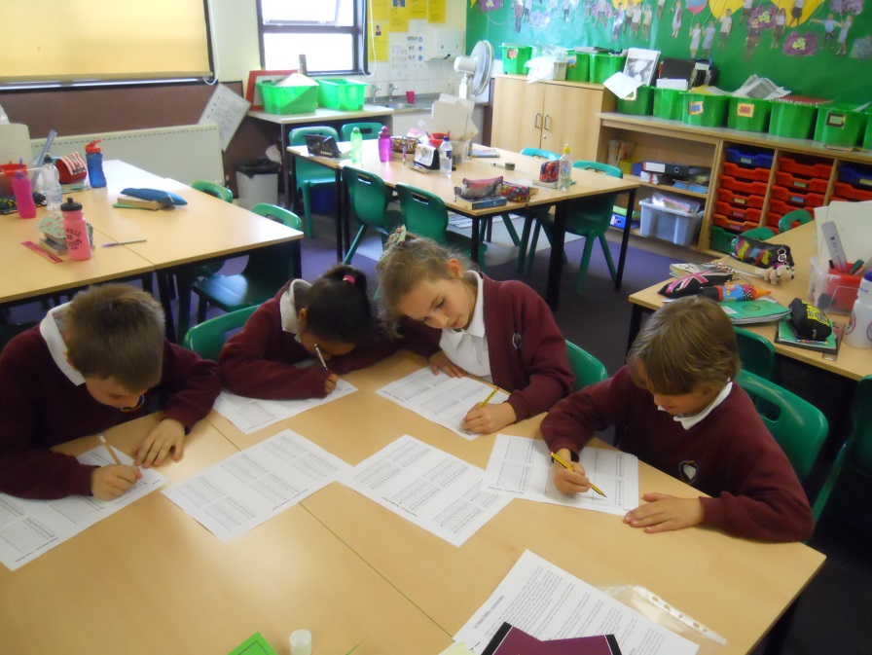
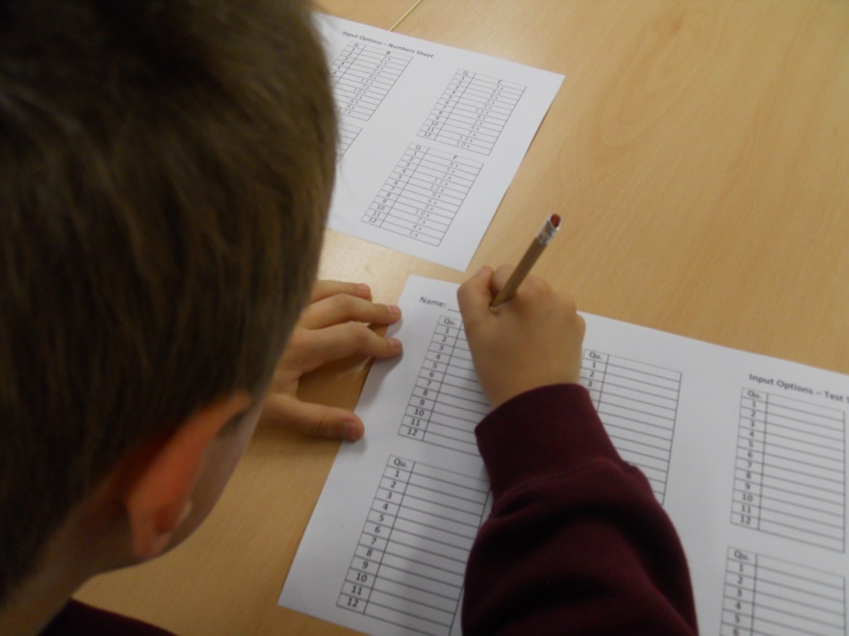
How do we do it?
St Paul’s CE Junior School’s
100 Club
Name___________________
Class __________

Slide 12
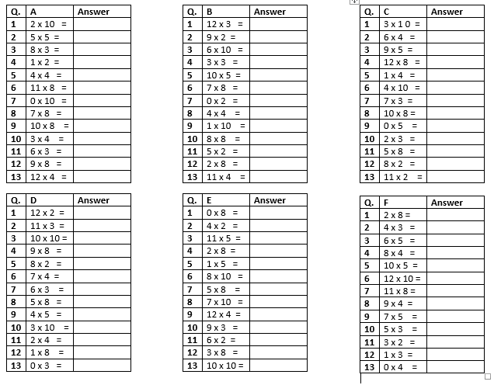
Blue passport: 2, 5, 10, 3, 4, 8, Random
Green passport: 6, 7, 9, 11, 12, Random

Slide 13
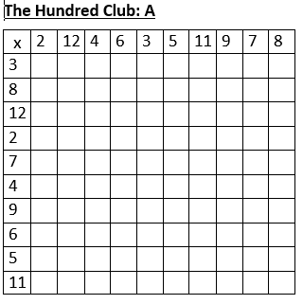
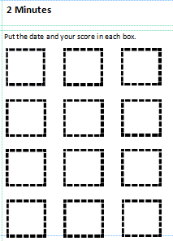
Record how many can they answer in 2 minutes

Slide 14
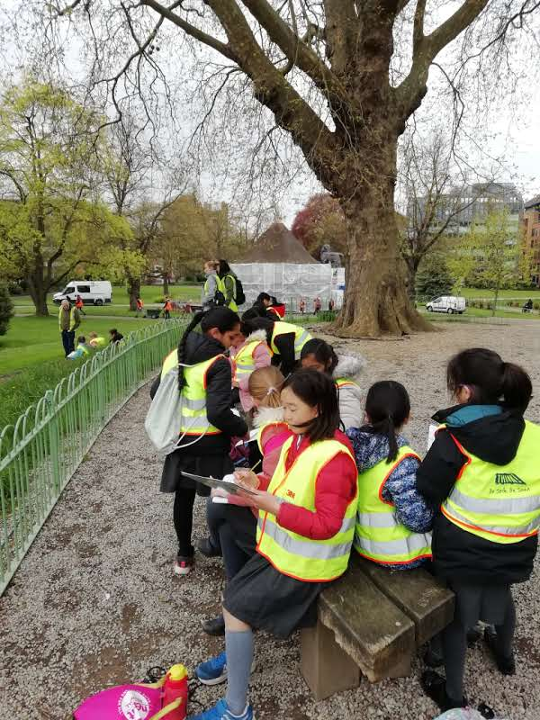
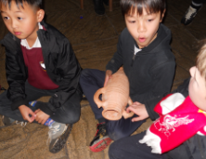
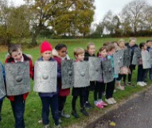
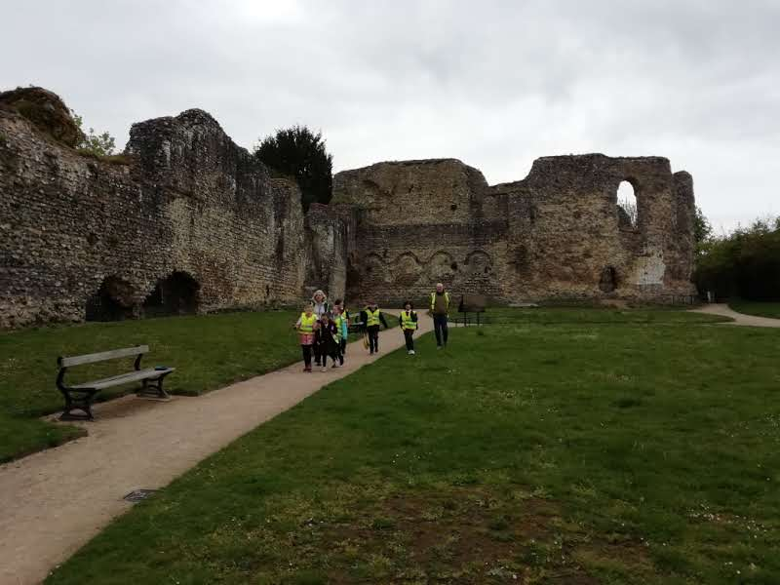
History and geography
History: Geography topics:
Romans in Britain Reading: features of a town
Anglo-Saxons Antarctica
Rainforests

Slide 15
science
Topics:
Living things and their habitats
Teeth and digestion
Sound
States of matter
Electricity

Slide 16
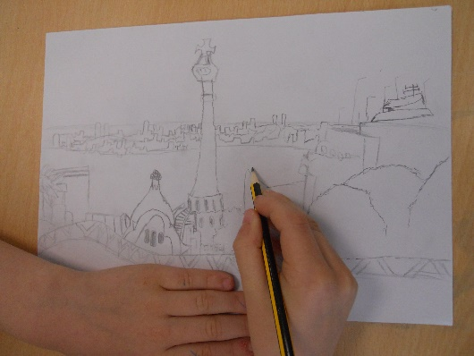
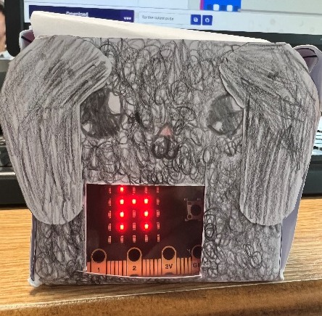
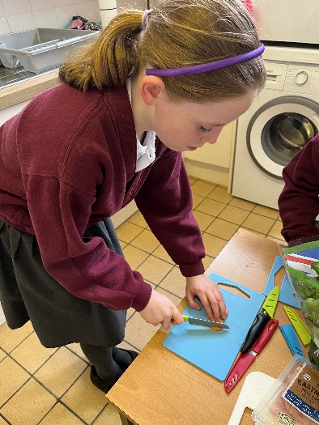
Art and design and technology
Art topics: DT topics:
Still Life Food technology
Gaudi inspired landscapes Roman chariots
Picasso inspired carnival masks Light boxes using micro-bits

Slide 17
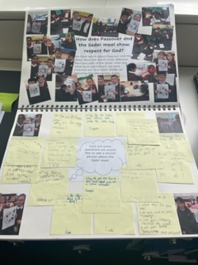
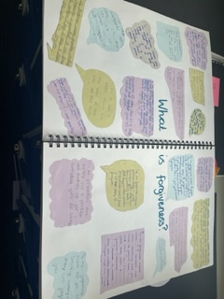
Re and psrHe
RE topics: PSRHE topics:
Judaism – beliefs and practices, Passover, rites of passage Being me in my world
Christianity – Christmas, Easter – forgiveness, Celebrating difference
Prayer and Worship Dreams and goals
Healthy me
Relationships
Changing me

Slide 18
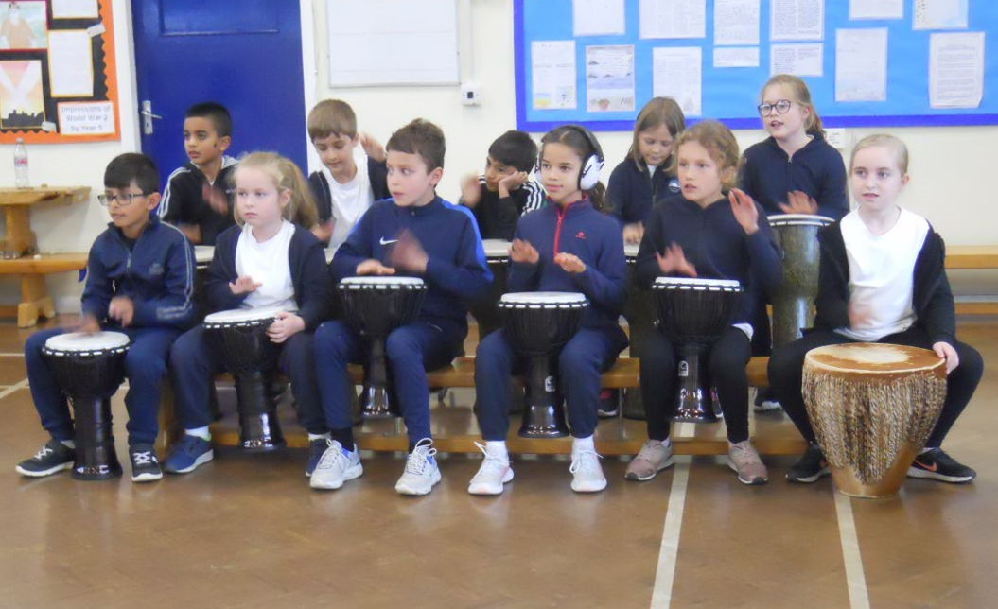
Music and French
Music topics: French
Composing with Glockenspeils We follow the Cave languages scheme of work
Roman music
Opera
Rainforest music
Charanga units

Slide 19
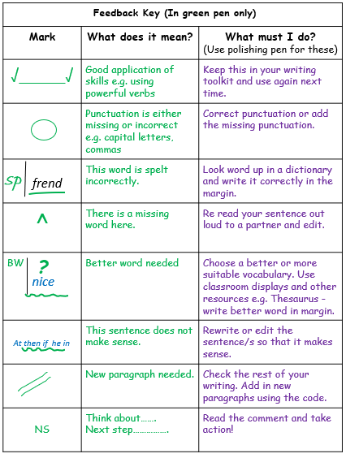
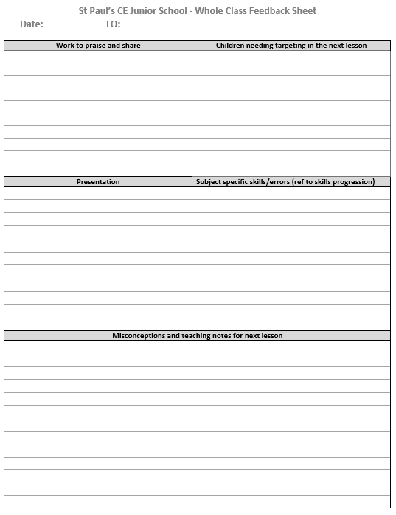
Assessment and Marking
Lessons have a learning objective which is written at the top of a piece of work.
After each piece of work, the pupils are encouraged to self-assess their understanding. They place a ‘traffic light’ colour after the learning objective:
green for ‘understood’
amber for ‘almost got it’
red for ‘help! I’m stuck!’
In English, we mark using an agreed set of feedback codes
which are understood by the children. They respond to
these using purple pens to edit and improve their work.
We often provide instant feedback in writing, maths and other
curriculum subjects, and use whole class marking to identify
common misconceptions and target children.

Slide 20
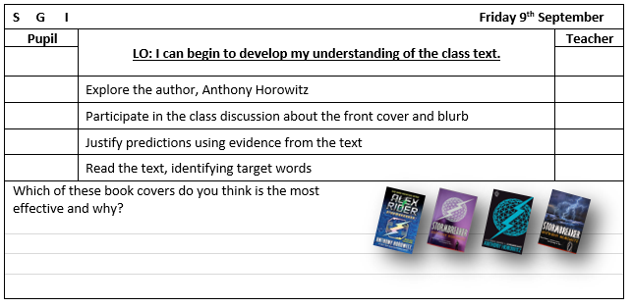
Assessment and Marking
There will also be evidence of self and peer assessment when the children assess their own and each other’s work. They work to a set of agreed criteria.
Teachers are continually assessing pupils throughout lessons and using this to adapt and inform the delivery of the curriculum.
Progress is continually monitored, both formally and informally, throughout the year. Each term the class teachers meet with the Head and Deputy to formally review the individual progress of every child.

Slide 21
Home Learning
Home Learning will be set on a Tuesday and handed in on the following Monday.
It will be set on teams by way of a homework schedule which includes links to any online sites required.
Strategies to support spelling are on our website.

Slide 22
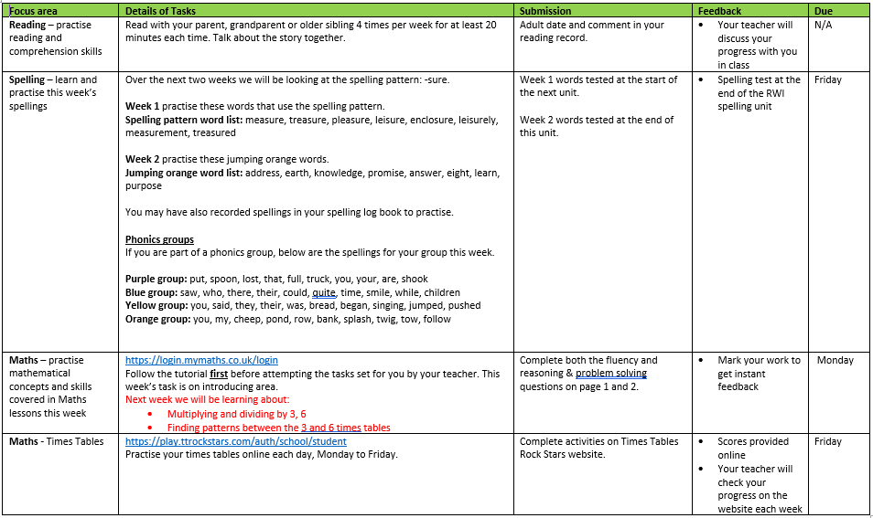
Home Learning

Slide 23
Focus Areas
Daily reading – Reading Journal completed by a parent/carer at least 3 times a week;
Spelling – focus on specific spelling patterns and words found in spelling log book;
Multiplication/division tables.

Slide 24
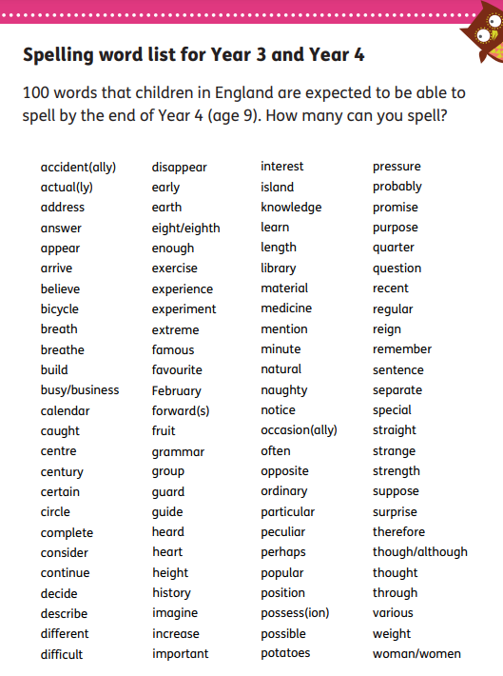

Slide 25
PE Days
 | 4P | 4R | 4B
Indoor PE (after half term) | Tuesday | Friday | Friday
Swimming | Tuesday | Wednesday | Wednesday
Outdoor Games | Thursday | Thursday | Thursday

Slide 26
PE and Swimming
PE Kit
Navy or black tracksuit bottoms/shorts
White t-shirt
Navy or black sweatshirt
Trainers
Socks
Swimming
One-piece swimsuit or trunks (not long, loose fitting)
Goggles (with the kite mark)
Towel
Swimming hat
All earrings must be removed for PE and swimming for health and safety reasons. Children will no longer be permitted to put tape over their earrings as this does not remove the risks associated.
If your child comes to school with their earrings in, they will have to remove them themselves. If they are unable to do this, they will not be allowed to participate in the lesson.
We recommend on outdoor PE days that school uniform is brought in a bag in case the children require a change of clothes.

Slide 27
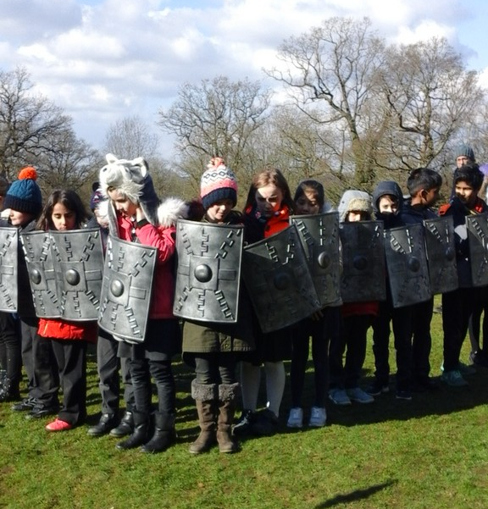
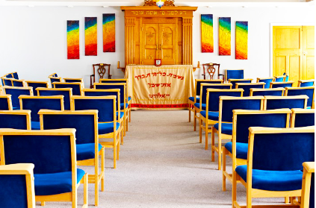
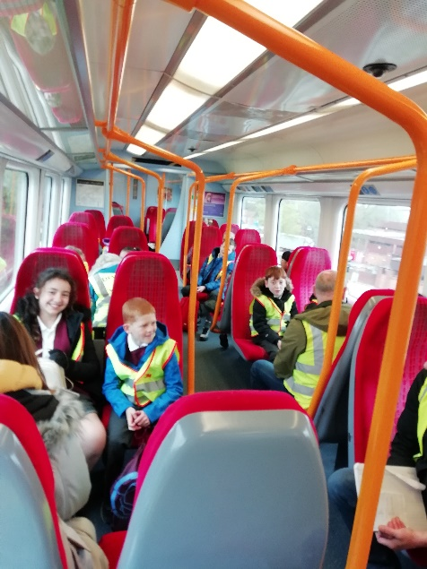
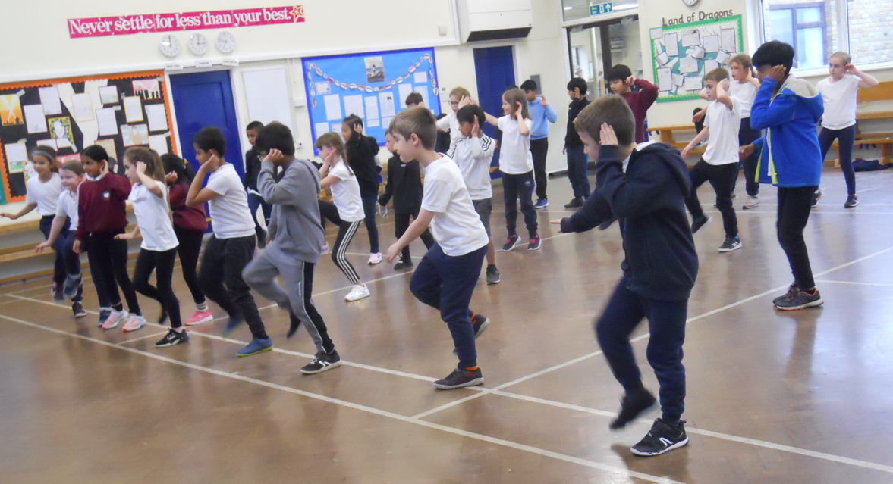
Enrichment
Day trip to Ufton Court
Visit a Synagogue
Geography field trip
Music and dance workshops

Slide 28
Weekly Newsletter
The newsletter can be found on the Welcome page of the website. A link is sent out by Parent Mail when there is a new newsletter.
It includes useful information such as upcoming dates, safeguarding information and events that have been happening in school.

Slide 29
Any questions?

