Slide 1

welcome
Year 5 curriculum information evening
Notes:
Kerry

Slide 2
The Year 5 Team
5D - Mrs Dwyer (Team Leader)
5K - Mr Kellett
5M – Miss Osborne
Mrs Keen PPA and Leadership Cover
Each class is supported by Learning Mentors: Mrs Judd and Mrs Long in 5D; Mrs Hallows and Mrs Alessandrini in 5K and Mrs Grabkowska and Miss Chiu in 5M. We also have support from Mr Clarke and Mrs Brodie.
Notes:
Kerry

Slide 3
Our Core Values
Our core values guide the actions of our staff and children and bind us together as a strong community.
We are caring and we are kind.
We are always ready to learn.
We are determined and we are resilient.
We embrace difference and diversity.
We have a voice and we listen to others.
We encourage and we cooperate.
We contribute positively to our community.
We are environmentally responsible.
Notes:
Jotham

Slide 4
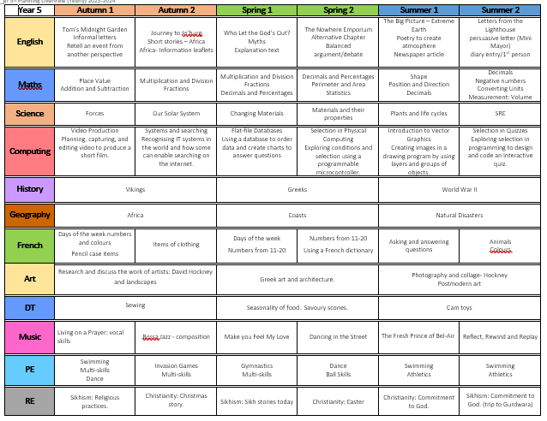
Notes:
Kerry

Slide 5
English
The majority of our writing is linked to the texts we read in Guided Reading or our history and geography topics.
This term, we are writing informal letter between Tom and his brother Peter from Tom’s Midnight Garden and short stories and information leaflets about Africa.
Notes:
Kerry

Slide 6

Reading
Each term children take a Star Reader assessment which gives each child a ZPD score (this is the recommendation of book levels that this child should read to provide optimal challenge without frustration.)
Children are encouraged to choose a reading book within this range from their class library.
Accelerated Reader Quizzes – children take a quiz about the book within 48hrs of finishing a book to earn points.
Notes:
Kerry

Slide 7







Guided Reading
Notes:
Kerry

Slide 8

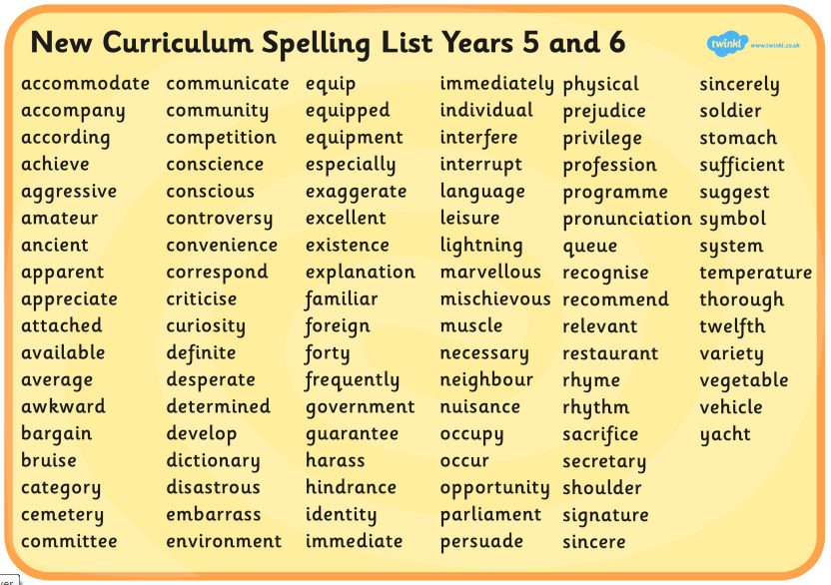


Spellings
Notes:
Kerry

Slide 9
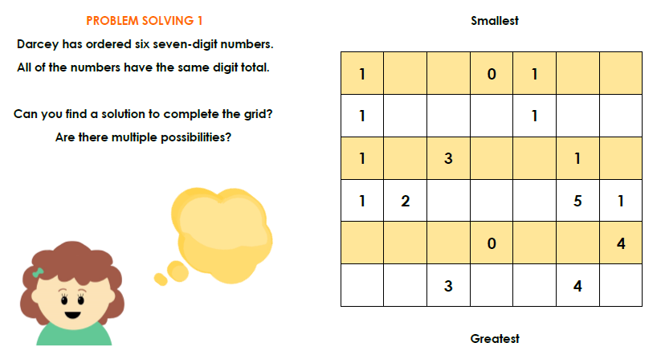
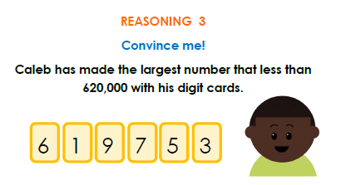
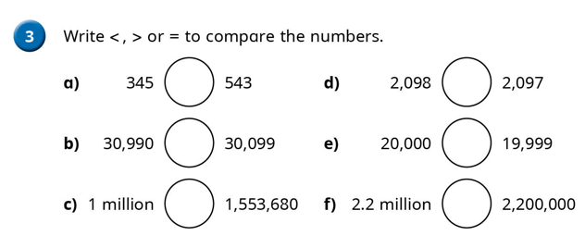
Maths
We follow the White Rose maths scheme with challenge provided from Planpanion. Each lesson provides the opportunity for children to develop their fluency, reasoning and problem solving skills.
Notes:
Jotham

Slide 10
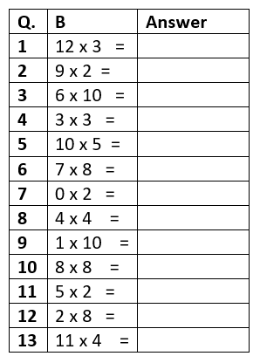
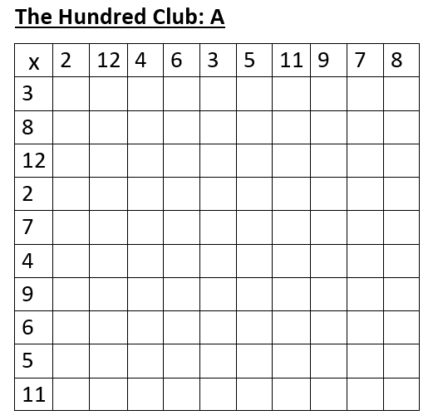
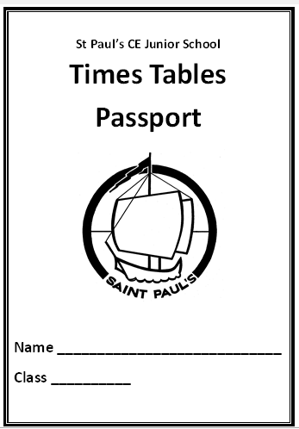
Maths
Times Table Passport every Friday
Blue passport: 2, 10, 5, 3, 4, 8
Green passport: 6, 7, 9, 11, 12
Yellow passport: The Hundred Club
Notes:
Jotham

Slide 11

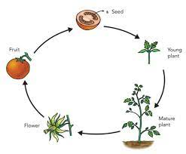

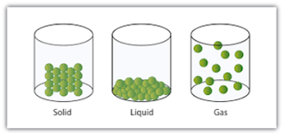
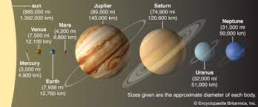
Science
Plants and Life Cycles
Forces
SRE
Solar System
Materials
Notes:
Keighly

Slide 12

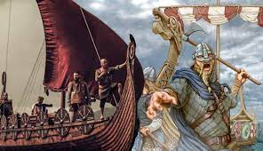
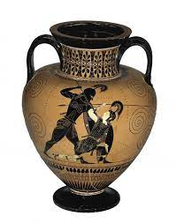


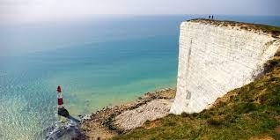
History and Geography
Vikings
Ancient Greece
Africa
Coasts
Natural Disasters
Notes:
Jotham

Slide 13
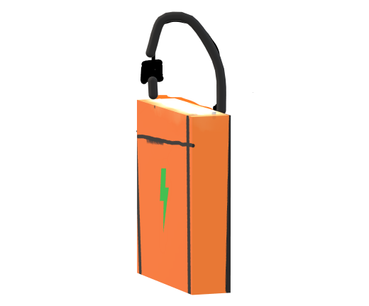
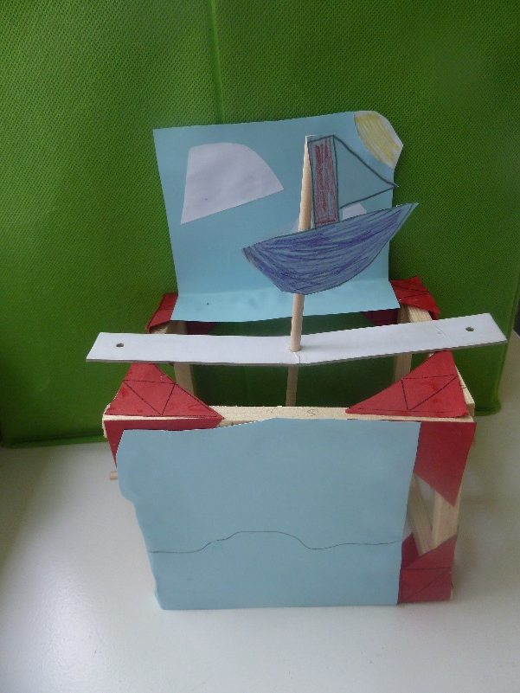
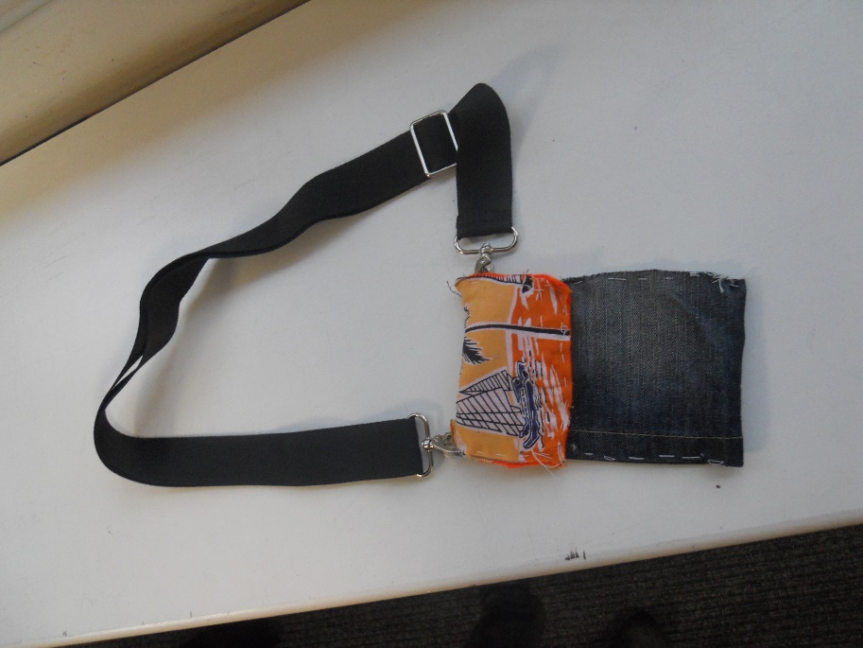
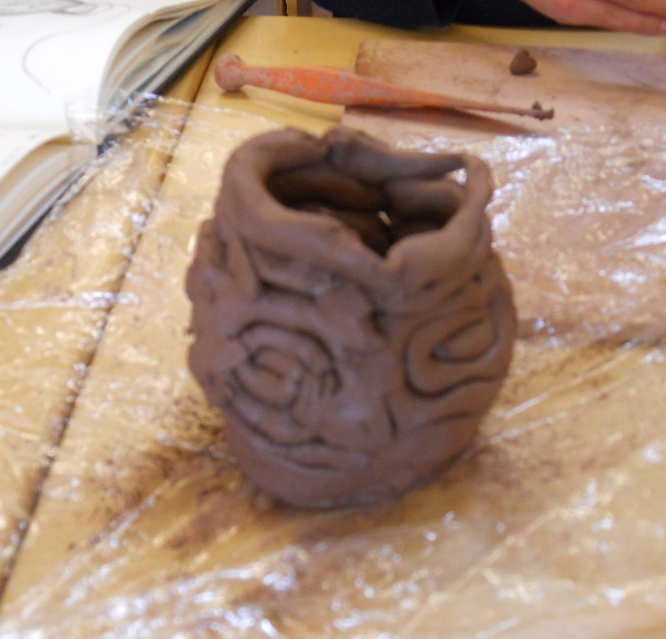
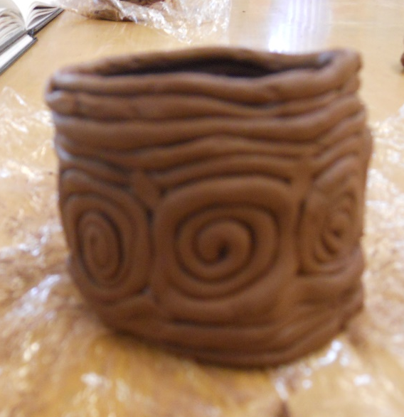
Art and DT
Notes:
Keighly

Slide 14

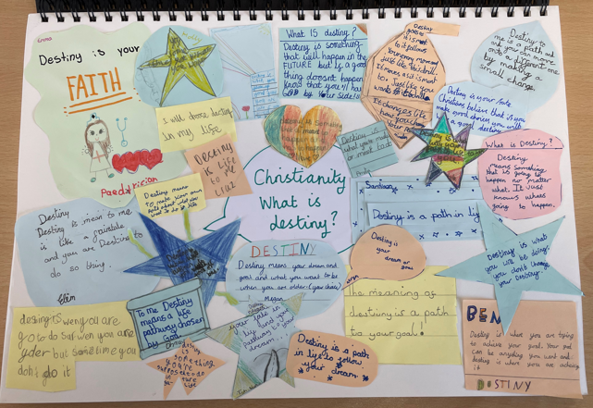


RE and PSRHE
Notes:
Kerry

Slide 15


Music and French
Rock, Jazz and Pop Ballads
Nouns, masculine and feminine and adjectives
Notes:
Kerry

Slide 16



PE and Swimming Timetable
5D Monday - Swimming
5K Tuesday - Swimming
5M Wednesday - Swimming
Thursday (all of Y5)
Indoor PE – same as swimming slot
Please make sure children wear full kit to school on Thursdays, including trainers. Hair must be tied back and all jewellery removed or taped before coming to school.
Notes:
Keighly

Slide 17
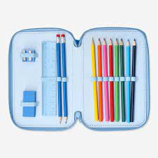
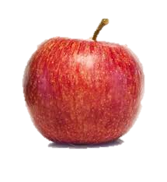
Information and Equipment
Children should bring:
swimming kit on their swimming days;
a reading book and their Reading Journals;
a small pencil case with handwriting pen, pencils, rulers, rubbers, glue stick, scissors and coloured pencils;
a water bottle with a sports top;
a healthy snack for break.
Notes:
Keighly

Slide 18
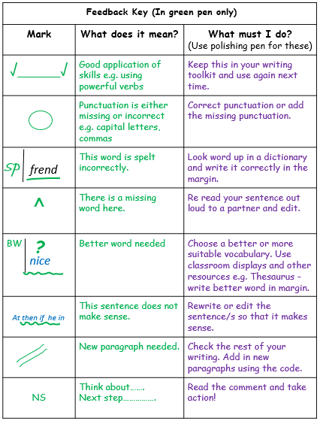
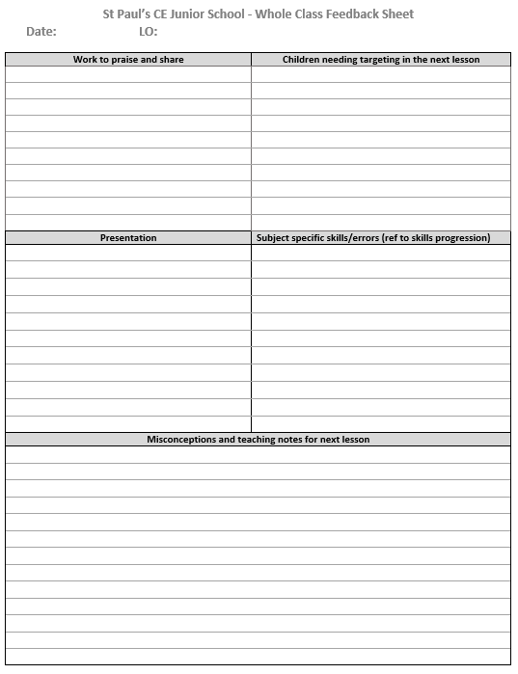
Assessment and Marking
Lessons have a learning objective which is written at the top of a piece of work.
After each piece of work, the pupils are encouraged to self-assess their understanding. They place a ‘traffic light’ colour after the learning objective:
green for ‘understood’
amber for ‘almost got it’
red for ‘help! I’m stuck!’
In English, we mark using an agreed set of feedback codes
which are understood by the children. They respond to
these using purple pens to edit and improve their work.
We often provide instant feedback in writing, maths and other
curriculum subjects, and use whole class marking to identify
common misconceptions and target children.
Notes:
Kerry

Slide 19
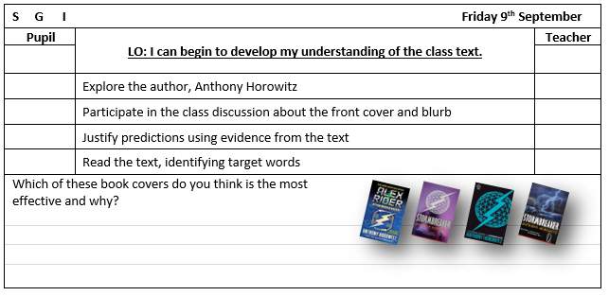

Assessment and Marking
There will also be evidence of self and peer assessment when the children assess their own and each other’s work. They work to a set of agreed criteria.
Teachers are continually assessing pupils throughout lessons and using this to adapt and inform the delivery of the curriculum.
Progress is continually monitored, both formally and informally, throughout the year. Each term the class teachers meet with the Head and Deputy to formally review the individual progress of every child.
Notes:
Kerry

Slide 20

Home Learning
Home Learning will be set on a Tuesday and handed in on the following Monday.
It will be set on Teams by way of a homework schedule which includes links to any online sites required.
Parents will receive a letter about homework in the coming days.
Strategies to support spelling will be posted on our website.
Notes:
Jotham

Slide 21
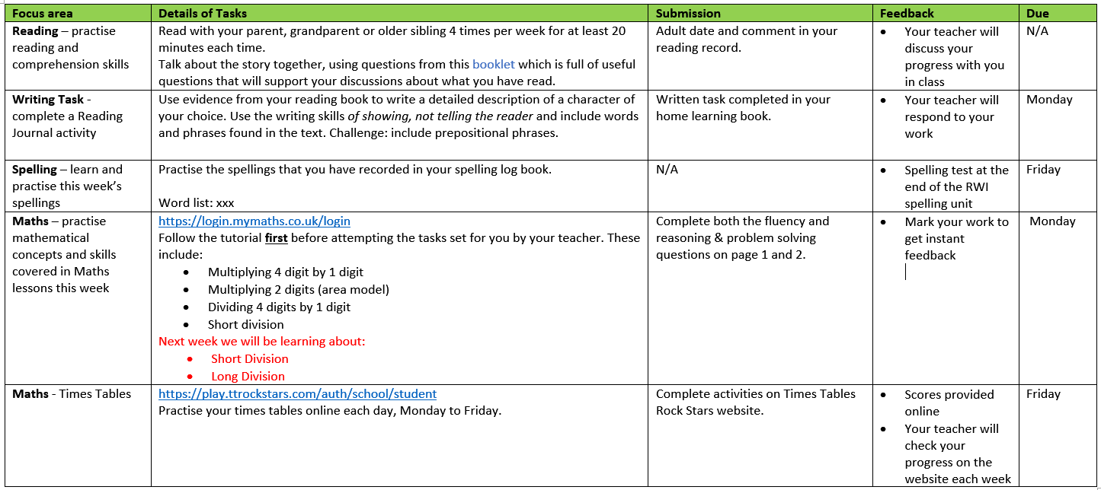
Home Learning
Notes:
Jotham

Slide 22
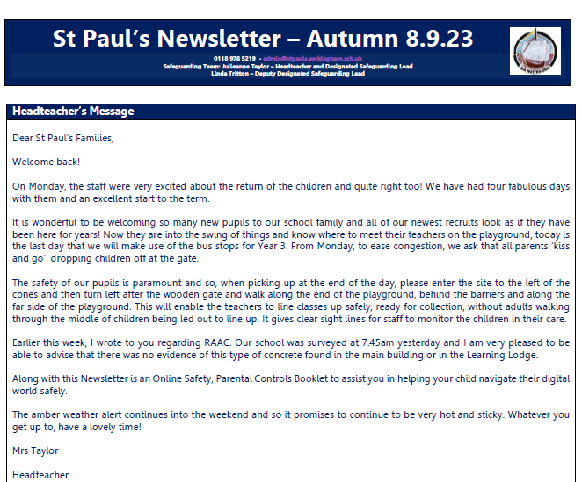
Weekly Newsletter
On the Welcome page of the website;
Link sent out by Parent Mail;
Useful source of information.
Notes:
Jotham

Slide 23
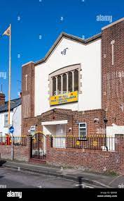
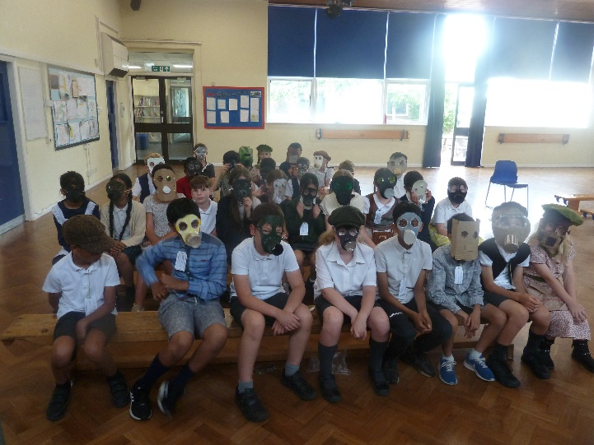
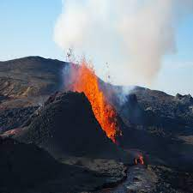

Enrichment Opportunities
Trips and Visits
  Winchester Science Museum
  Sikh Gurdwara
Music and Dance workshops
VR Natural Disasters
Topic Days
  Greeks
  WWII
Notes:
Kerry

Slide 24




Any Questions?
Notes:
Kerry

