Slide 1
Year 6 Curriculum Information Evening 2023
Wednesday 13th September 2023
We will send timetables home with all children by the end of the week.

Slide 2
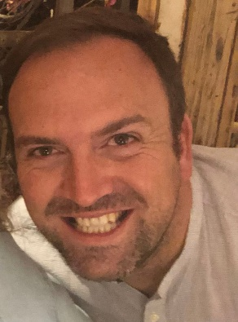
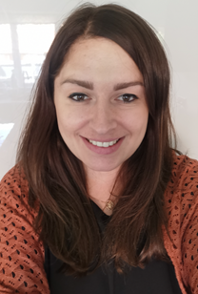
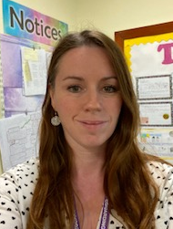
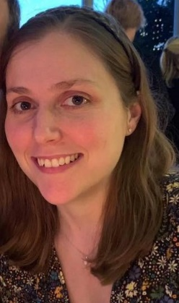
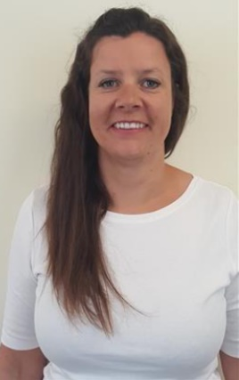
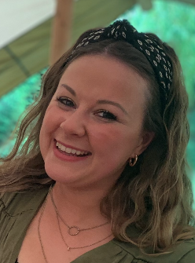
The Year 6 Team
6B
Mr Jex (M/Tu/W) - Class Teacher & Team Leader
Mrs Armstrong (W am, Th/F) - Class Teacher & Team Leader
Mrs Brodie/Mrs Holt - Learning Mentors
6T
Mrs Tritton - Class Teacher (M/Tu)
Mrs Thornhill - Class Teacher (W/Th/F)
Mrs Coe - Learning Mentor
6S
Mrs Tustin (M/Th/F) - Class Teacher
Miss Richardson (Tu/W) - Class Teacher
Mrs Foster - Learning Mentor

Slide 3
Our Core Values
Our core values guide the actions of our staff and children and bind us together as a strong community.
We are caring and we are kind.
We are always ready to learn.
We are determined and we are resilient.
We embrace difference and diversity.
We have a voice and we listen to others.
We encourage and we cooperate.
We contribute positively to our community.
We are environmentally responsible.

Slide 5
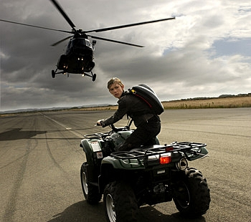
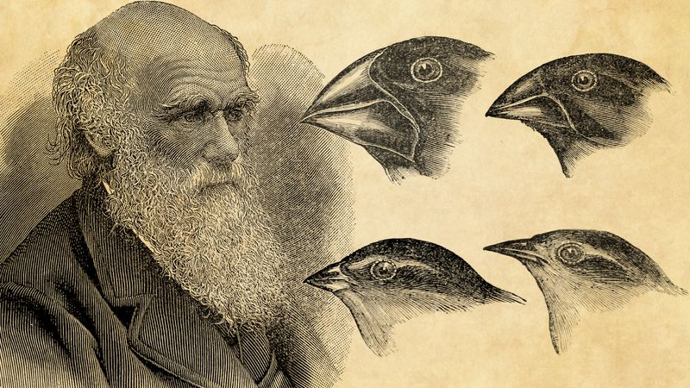
Writing
The majority of our writing is linked to the texts we read in Guided Reading or our topics in other subjects.
This term, we are writing persuasive adverts for a spy gadget and action scenes linked to our text Stormbreaker and autobiographies of Charles Darwin and David Attenborough linked to our Science topic of evolution.
Punctuation and grammar is taught and modelled in writing lessons.

Slide 6
Reading
Each term children take a Star Reader assessment which gives each child a ZPD score (this is the recommendation of book levels that this child should read to provide optimal challenge without frustration.)
Children are encouraged to choose a reading book within this range from their class library.
Accelerated Reader Quizzes – children take a quiz about the book within 48hrs of finishing a book to earn points.

Slide 7
Guided Reading

Slide 8
Guided reading
Monday: Shared whole class reading of the text
Tuesday: Book club
Clarify Predict Summarise Questioner
Wednesday: Modelled comprehension
Thursday: Independent comprehension
Friday: Review and whole class reading

Slide 9
maths
We follow the White Rose maths scheme with further challenge provided from Planpanion. Each lesson provides the opportunity for children to develop their fluency, reasoning and problem solving skills.
Homework is set via mymaths and linked to what has been learnt in class.

Slide 10
Maths
Times Table Passport every Friday
Blue passport: 2, 10, 5, 3, 4, 8
Green passport: 6, 7, 9, 11, 12
Yellow passport: The Hundred Club

Slide 11
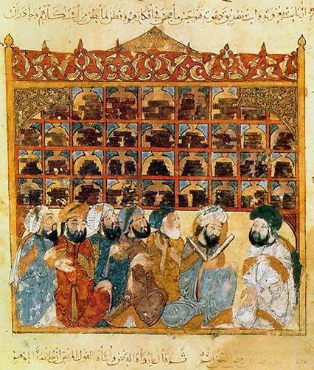
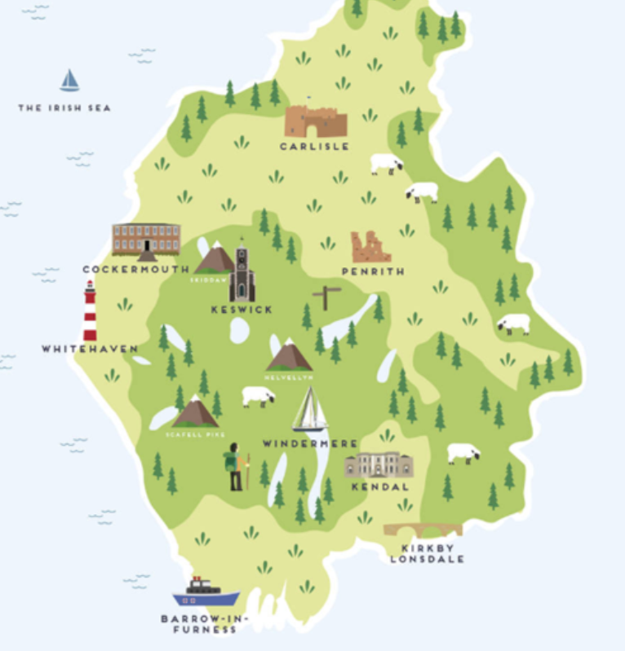
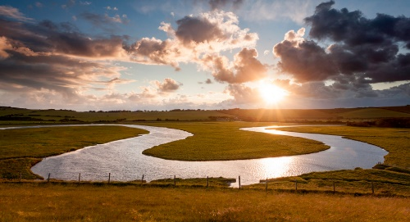
History and geography
History topics Geography topics
Ancient Egypt North America
Ancient Islamic Civilisations Rivers
The Windrush The Lake District

Slide 12
PSRHE and re
Being Me Islam
Celebrating Difference Christianity
Dreams & Goals
Healthy Me
Changing Me

Slide 13
Music and French
Music topics: French
Singing and using Glockenspeils We follow the Cave languages scheme of work.
Egyptian music We are looking at shapes and colour poems this term.
Online composition
Rivers soundscape
Charanga units

Slide 14
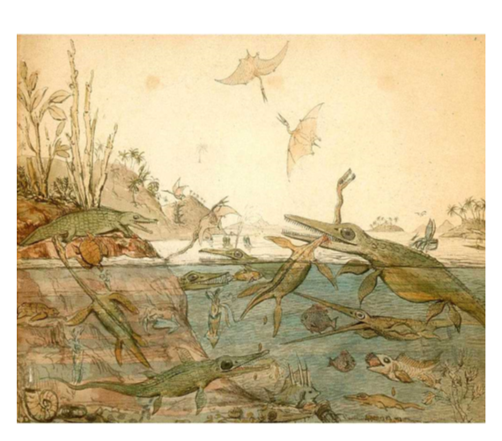
science
Topics:
Evolution and inheritance
Classification
Light
Circuits
Healthy bodies

Slide 15
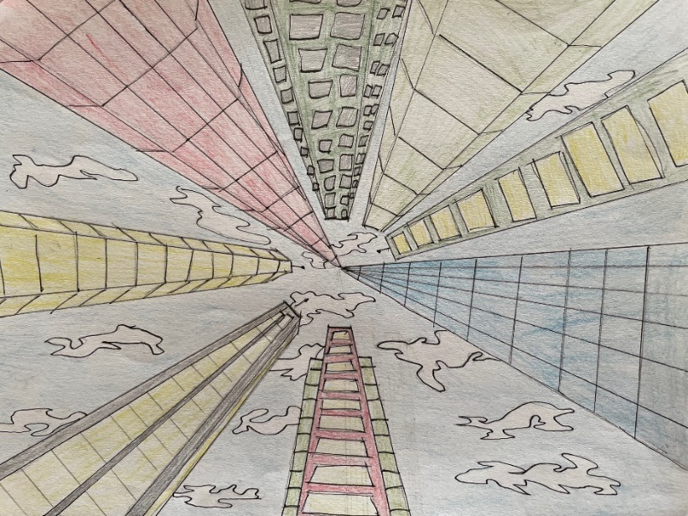
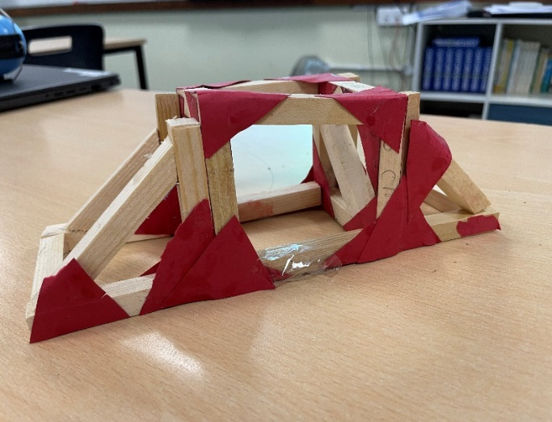
Art and design and technology
Art topics: DT topics:
Proportion and the human body Bridge building
Perspective and landscapes Cookery project – cook a meal at home
Islamic art – design a clay tile Programming Microbits

Slide 16
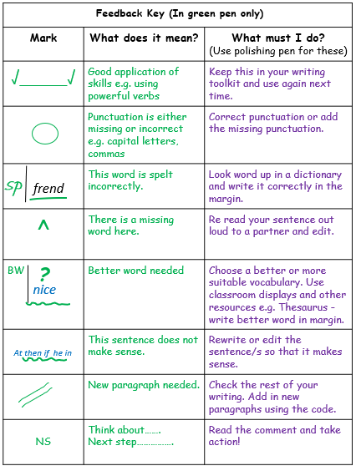
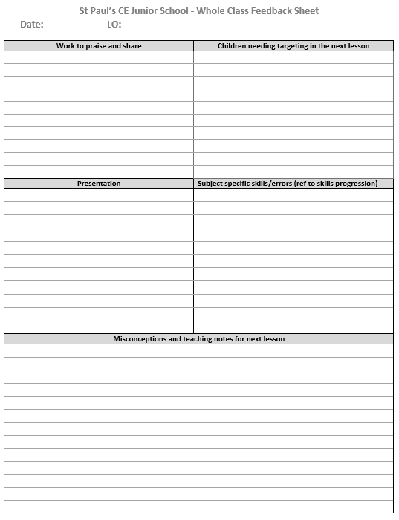
Assessment and Marking
Lessons have a learning objective which is written at the top of a piece of work.
After each piece of work, the pupils are encouraged to self-assess their understanding. They place a ‘traffic light’ colour after the learning objective:
green for ‘understood’
amber for ‘almost got it’
red for ‘help! I’m stuck!’
In English, we mark using an agreed set of feedback codes
which are understood by the children. They respond to
these using purple pens to edit and improve their work.
We often provide instant feedback in writing, maths and other
curriculum subjects, and use whole class marking to identify
common misconceptions and target children.

Slide 17
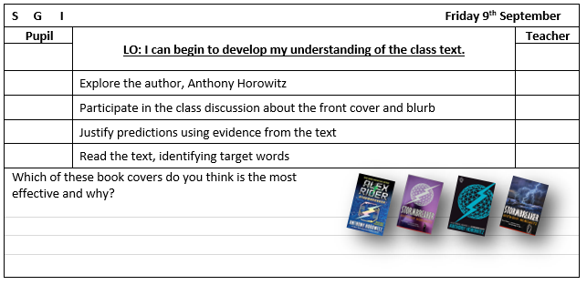
Assessment and Marking
There will also be evidence of self and peer assessment when the children assess their own and each other’s work. They work to a set of agreed criteria.
Teachers are continually assessing pupils throughout lessons and using this to adapt and inform the delivery of the curriculum.
Progress is continually monitored, both formally and informally, throughout the year. Each term the class teachers meet with the Head and Deputy to formally review the individual progress of every child.

Slide 18
Home Learning
Home Learning will be set on a Tuesday and handed in 10 days later on a Friday. Homework will be marked together on the Friday.
It will be set on Teams by way of a homework schedule which includes links to any online sites required.
Homework will start next week.
Strategies to support spelling are on our website.

Slide 19
Home Learning

Slide 20
Focus Areas
Daily reading – Reading Journal completed by a parent at least three times each week;
Spelling – focus on specific spelling patterns and words as well as words from the Year 5 and 6 spelling list;
SATs revision in Spring

Slide 22
PE Days
 | 6B | 6T | 6S
Indoor PE (after half term) | Tuesday | Friday | Monday
Swimming | Friday | Friday | Friday
Outdoor Games | Thursday | Thursday | Thursday

Slide 23
PE and Swimming
PE Kit
Navy or black tracksuit bottoms/shorts
White t-shirt
Navy or black sweatshirt
Trainers
Socks
Swimming
One-piece swimsuit or trunks (not long, loose fitting)
Goggles (with the kite mark)
Towel
Swimming hat
All earrings must be removed for PE and swimming for health and safety reasons. Children will no longer be permitted to put tape over their earrings as this does not remove the risks associated.
If your child comes to school with their earrings in, they will have to remove them themselves. If they are unable to do this, they will not be allowed to participate in the lesson.
We recommend on outdoor PE days that school uniform is brought in a bag in case the children require a change of clothes.

Slide 24
KS2 SATs
Week commencing 13 May 2024 and will last four days.
Tested for maths (one arithmetic test and two reasoning and problem solving tests), reading, spelling and punctuation and grammar with a teacher assessment for writing also submitted.
There will be a meeting in the new year to discuss the KS2 SATs.

Slide 25
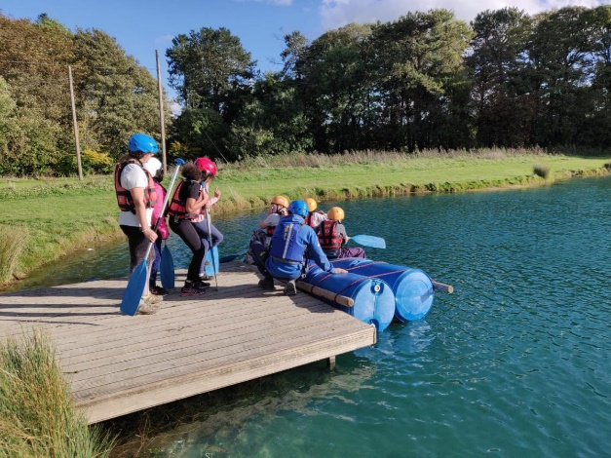
Enrichment
Autumn term
Residential trip to Liddington.
17/10 - 20/10
Those who are not attending have fun project work and activities in school.
Next year
Bassistry Arts
Author visit tbc
Visit a Mosque
Visit a local rivers
Enterprise Day
Production
Dates tbc

Slide 26
Weekly Newsletter
The newsletter can be found on the Welcome page of the website. A link is sent out by Parent Mail when there is a new newsletter.
It includes useful information such as upcoming dates, safeguarding information and events that have been happening in school.

Slide 27
Any questions?

